Slide 1

Money Honey Financial Services Pvt. Ltd. Mutual Fund

Slide 2
Table of contents
Introduction
What is Compounding?
What is Mutual fund?
Advantages of Mutual fund
What’s the catch in Mutual fund?
Frequent questions in the mind of investors
Answers
Types of Mutual fund
Equity Mutual fund
Debt Mutual fund
Hybrid Mutual fund
How to build Mutual fund portfolio?
Different ways of investing money
Redemption of Mutual fund
Growth or Dividend
Tax implication

Slide 3
1. Introduction

Slide 4
What is Investment?
It simply means putting money into an asset today to get capital appreciation over the period of time.
Investments should be done according to your personal financial goals, funds available.
Investment can be done in mutual funds, stocks, bonds, real estate etc.
Investment has a potential to increase the wealth exponentially via compounding.
Every investment is associated with some risk, but this risk can be mitigated to generate superior returns by having skills or by taking advise from professional.

Slide 5
2. What is Compounding?

Slide 6
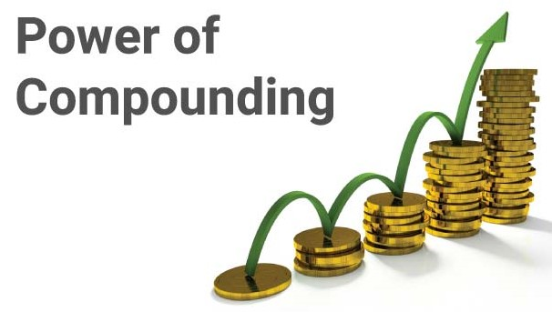
What is Compounding?
Compounding refers to the increasing value of an asset rapidly due to the interest earned on both a principal and accumulated interest.
The amount increases exponentially because the interest is not withdrawn; it is reinvested to generate additional returns.
The compound interest provides a higher return than simple interest. The simple interest calculate interest only on the principal sum.

Slide 7



Slide 8
3. What is Mutual fund?

Slide 9
What is mutual fund??
Is a type of financial instrument.
Mutual funds made by a pool of money collected from investors.
The fund manager invests that collected money from investors into securities like bonds, stocks etc.
This helps investors to grow their wealth.
So the investors starts getting returns from their investments.
These securities where fund managers invested money starts generating income.

Slide 10
4. Advantages of Mutual fund

Slide 11

Advantages of Mutual Fund
Diversification of funds across market and sectors
When investor invests money into any security, it automatically spread across market & multiple sectors.
The main benefit of this is if one security underperforms, other may be make up.
Each market, each sector performs differently from each other.

Slide 12

Advantages of Mutual Fund
Easy process to start and close
Any individual can start investing in mutual fund based on his financial goals, age, income.
If he has skill he can select scheme himself or can take financial advisors help who will guide him.
Investment process can be done online which saves one’s time or can be done through offline who don’t want to go online.
Once an individual reach his financial goal he can easily withdraw the money.

Slide 13

Advantages of Mutual Fund
Customize scheme
In market various mutual funds schemes are available which can be selected based on individual’s income, age, dependent family members, patience to wait & watch market performance.
An individual can select scheme if he has knowledge about market & his priorities or he can take help from expert management to create his portfolio.
Expert management can guide individual to create his portfolio and advice to update his portfolio time to time.

Slide 14
5. What’s the catch in Mutual fund?

Slide 15

What’s the catch in Mutual fund?
In mutual fund investor’s money invests into different financial securities like debt, equity, bonds etc. Each security will perform differently to each other.
No one can predict future activities accurately. So any sector or market can under perform or performs very high.
Any global (market crisis etc) or domestic (policy change in particular sector etc) change may rise or down the performance of investment, which no one can control.
But there are other factors too which can be mitigated through in advance planning.
Each individual's patience is different while seeing these changes.

Slide 16
6. Frequent questions in the mind of investors

Slide 17



Frequent questions in the mind of investors
Various schemes in the market creates confusion. Who
will help me in selecting scheme as per my financial
goals?
What is the meaning of portfolio diversification?
What is meaning of portfolio?

Slide 18
7. Answers

Slide 19


Slide 20

Answers
Various schemes in the market creates confusion. Who will help me in selecting scheme as per my financial goals?
Reach out to financial advisors.
Financial advisors can assist in creating a investment portfolio.
Financial advisors can help in selecting scheme combinations to investors on basis of investor’s age, financial goals, income, patience to see market performance.

Slide 21
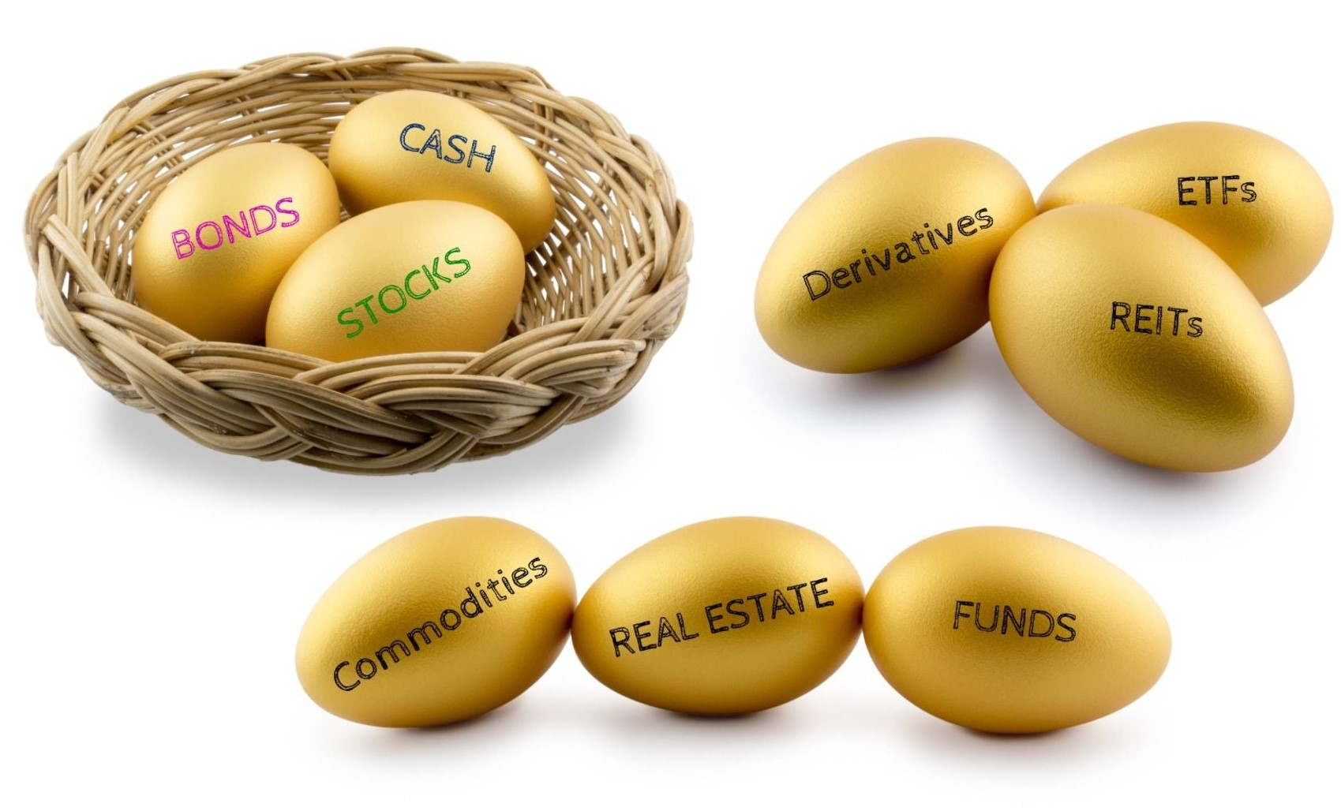
How to mitigate the risk?
What is the meaning of portfolio diversification?
Investors should not invest all his earnings into one asset.
Always invests money into different assets, sectors, markets to get more exposure.
If any one fund underperforms, another may make up for the loss.

Slide 22

How to mitigate the risk?
How to make portfolio?
Mutual Fund investments are made based on investors profile.
While creating a portfolio investors have to consider their age, income, number of dependents, the duration for the goal, and patience to see market performance.
Example - Investors with low to moderate risk appetite and long term goal can go with equities.
Example – Investors with low-risk appetite can select debt funds.

Slide 23


Slide 24
8. Types of Mutual fund

Slide 25
Types of mutual funds
Equity
Invests in listed equity & related instrument.
Co.'s divided as per their market capitalization.
Debt
Invests in fixed income instruments.
Suitable for those who want regular income.
Hybrid
Invests in both equity & debt.
Provide balanced profile with blend of growth & moderate risk.

Slide 26
9. Equity Mutual fund

Slide 27

Definition
Equity Fund
It is mutual fund invest predominately in equity stocks.
It must invest at least 65% in equities and related instruments.
Equity funds can be divided as per market capitalization.
Equity funds can give capital appreciation & have the potential for long term wealth creation.

Slide 28
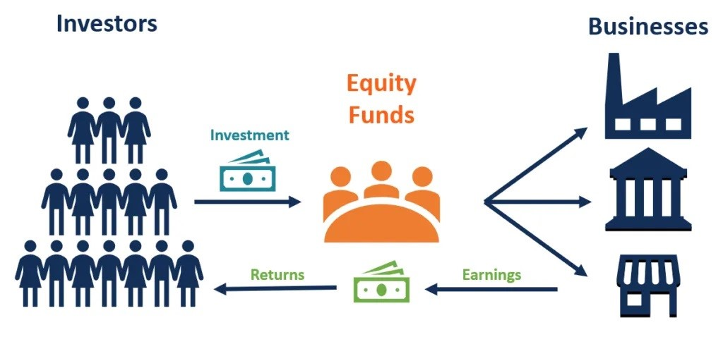

Slide 29
Types of Equity Mutual fund
Large cap mutual fund
Top 1-100 Co.’s listed in NSE
Stable, mature, rules the market.
Tend to less volatile in market fluctuation.
Less riskier than Mid cap & Small cap.
Mid Cap Equity Funds
Focuses on Co. range in listed stocks-101st to 250th.
Less riskier than small cap and more than large cap.
Potential to give high returns if keep for longer tenure

Slide 30
Types of Equity Mutual fund
Large & Mid Cap Funds
Invests in India’s top 1-200 listed Co.’s.
Blend of top large cap and promising mid cap co.
Ideal for investment horizon more than 5 years.
Small Cap Funds
Invests in Beyond 250 listed Co.’s, mostly unheard.
High risky than large cap & mid cap
Potential to deliver high returns if keeps longer tenure.

Slide 31
Types of Equity Mutual fund
Multi Cap Funds
Compulsory to invest minimum 25% in each Small, Mid, Large cap & rest 25% as per fund manager’s decision.
Exposure in multiple sectors under one investment.
Flexi Cap Funds
No fix market cap restriction at time of investment.
Fund manager has more flexibility to select investment than multi cap.

Slide 32
Benefits of Equity Fund
Gets exposure by investing in various market , sector under one investment.
Balancing the risk,
if one security under performs other may give better return.
Getting advised by fund managers, investment specialist to achieve optimum result to investors.
Compounding power by
re-investing fund enhances the invested capital.

Slide 33
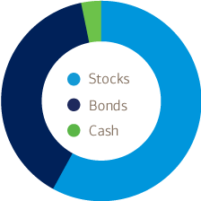
Allocation of funds
Set aside enough money in cash to handle emergencies & near term goals.
Subtract your nearby age from 100, example if you are in your 20’s then 80% in stocks & 20% in Bonds.
The younger and more affluent you are, the higher the percentage.
Diversify Within Investment Categories.

Slide 34

Who should invests in Equity Fund?
Those have long term financial goals (marriage, buy house/vehicle, child education, retirement plan)
An aspiring investor who wants an exposure in market.
Those wants to enjoy benefit of compounding, i.e. income from principle & on it’s interests also.
Those who have market knowledge and ready to take calculative risk.

Slide 35
10. Debt Mutual fund

Slide 36
What are Debt Funds?
Debt Fund
It is mutual fund invests in fixed income instruments.
They are low cost, can give stable returns, highly liquid.
They are less volatile and less risky than equity fund.
Ideal for those who aim regular income but are risk averse or low risk taker.

Slide 37
Types of Debt fund
Liquid fund
Invests in money market instruments.
having maturity of maximum 91 days.
Liquid fund offers better returns than saving a/c.
Good alternative for short term investments.
Money market fund
Invests in money market instruments.
having maturity of maximum 1 year
Good for investors seeking low-risk debt securities for a short-term.

Slide 38
Types of Debt fund
Overnight Fund
Are safest among all mutual funds, having maturity of 1 day.
Suitable for businessman's who want to park large amount for short period until its utilized somewhere.
Banking PSU
These debt funds lend only to banks & public sector co.
Most borrowers are government backed, large banks so near to zero risks of non payment.
Ideal for at least 2-3 years investment horizon.

Slide 39
Types of Debt fund
Short duration debt fund
Average maturity period for these funds 1-3 years.
Can be alternative to bank deposits.
Ultra short duration debt fund
Average maturity period for these funds between 3-6 months.
It may provide low returns but lesser risky to interest rate change.

Slide 40
Types of Debt fund
Corporate bond funs
Issued by private and public corporations to raise money for a variety of purposes, like building a new plant, purchasing equipment, or growing the business.
Investor will get interest till maturity date.
Ideal for tenure 2-3 years.

Slide 41
Types of Debt fund
Credit risk fund
This is debt fund lend at least 65% of money to those co. whose credit rating is not so good, borrowers pay high interest rate due to poor credit rating.
Possibility of default is high.
Ideal for investment 3-5 years.
Deliver high return than bank fixed deposits but high risky too.
Gilt fund
These funds only invest in bonds and fixed interest-bearing securities issued by the state and central governments.
Very minimal risk as invest in Govt. body.
Ideal for risk averse people.

Slide 42

Who should invests in Debt Fund?
Those want regular income, but are risk averse.
Can be better option for those invests in term deposits, FD
Suitable for people near to retirement or retired as debts are less risky than equity funds.
Young investors too can start investing in debt as a part of portfolio.

Slide 43
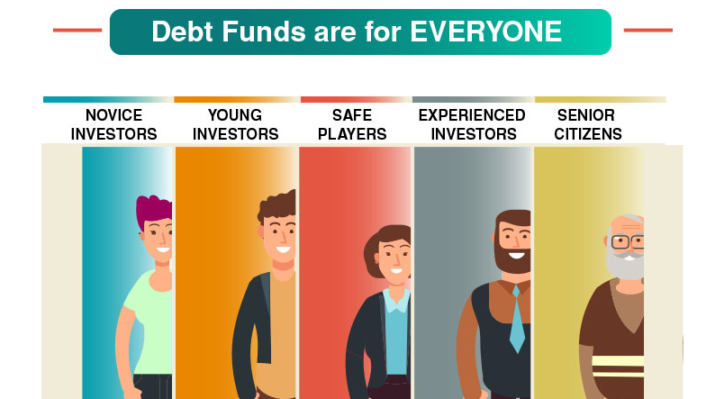

Slide 44
11. Hybrid Mutual fund

Slide 45


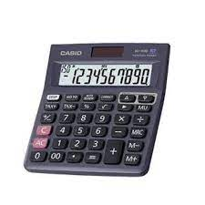
Difficult to carry everywhere?
Now carry everywhere.

Slide 46



Like to eat both?
Then have a pizza sandwich

Slide 47


Can’t move everyday?
Now everyday with you

Slide 48
Happy by using Hybrid products!!
Then continue your happiness with Hybrid mutual fund products??

Slide 49
What are Hybrid Mutual Funds?
Hybrid Fund
Hybrid Funds allow you to have a diversified portfolio with just one fund.
Hybrid Funds invest in a mix of asset classes i.e. Equity & debt together.
Can invest into hybrid funds for goals which want to achieve near 3 to 5 years.
Hybrid funds have potential to generate returns greater than Debt schemes with lower volatility than Equity schemes.

Slide 50
Benefits of Hybrid Mutual Funds
Benefits
These funds can be at lower risk than having full equity investment.
Getting portfolio diversification by investing in Equity and debt.
Hybrid funds can be convenient, save investors from hassle of investing in each asset class separately.
Notes:
Bob bnp

Slide 51
Who should invests in Hybrid Fund?
Investors looking for asset allocation through one fund.
Investors who want substantial equity exposure with less risk than full equity investments can in select hybrid fund.
Those looking for low-risk investment with higher returns than Fixed Income fund may select Hybrid .
Investors willing to create wealth in long term.
Investors with long term investment horizon can go with hybrid funds..

Slide 52
Types of Hybrid fund
Arbitrage fund
They simultaneously buy and sell of securities in different markets to take advantage of different prices.
Can be suitable for an investment horizon of 1-3 years
BAF (Balance advantage fund)
They invest in a mix of stocks and FD-like instruments.
This allocation is changing as per market conditions for optimal returns with minimal risk.
Can be suitable for an investment horizon of 3+ year.

Slide 53
Types of Hybrid fund
Multi asset fund
They investment minimum 10% of it’s portfolio in at least 3 asset classes, typically debt, equity and gold, real estate etc.
They increase/decrease its allocation according to the current market condition.
May suitable for an investment horizon of at least 3 years
Equity saving fund
They invests in equity, arbitrage, debt instruments.
It can be suitable for those looking for short term investment alternatives to debt funds & fixed deposits.

Slide 54


Slide 55
12. How to build Mutual fund portfolio?

Slide 56
How to build Mutual fund portfolio?
Identify your goals like buy house/vehicle, children’s education, marriage, retirement.
Select plan as per goals tenure to reach. If short term goals prefer debt fund, equity may give loss for short tenure.
Diversify risk by investing across market, sectors.
Start investing through SIP and gradually increase investment amount.
Review portfolio at least once a year. If any funds under performs 2-3 years, then can switch to better one.

Slide 57
13. Different ways of investing money

Slide 58

Different ways of investing money
Lump-sum investment means a one time investment.
It requires disposable amount in hand.
Lump-sum investments will be better suited if an individual investing at the end of a financial year.

Slide 59

Different ways of investing money
Systematic investment plan (SIP) is a facility to invest in a disciplined manner.
It is similar to a recurring deposit.
Can instruct bank to debit the specified amount on specific time interval.
SIP can be done on basis of daily, weekly, monthly, quarterly, half-yearly.

Slide 60

Different ways of investing money
SIP can be more suitable for those have a steady source of income, whereas if you have ideal funds you should consider lump sum.
SIPs are usually more suited for investment in volatile markets.
Lump sum investments have high returns potential.

Slide 61
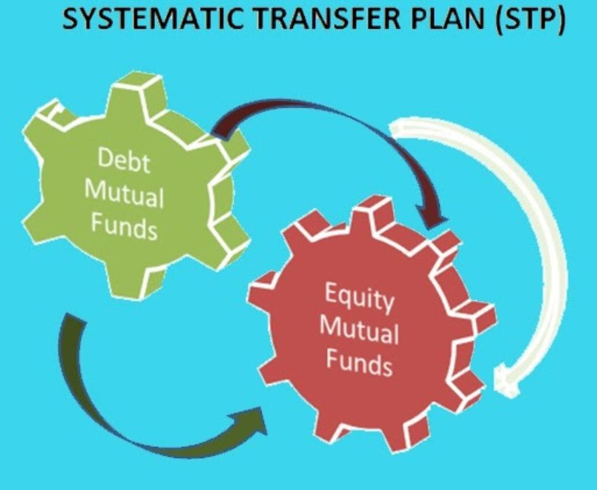
Different ways of investing money
STP (Systematic transfer plan) is to transfer amount from one scheme to other, it’s from debt to equity or vice versa.
Transfer happens periodically to get higher gain to investors when other securities offer high returns.
An investor should have considerable knowledge about market trends and patterns if wish to go with STP.

Slide 62

Different ways of investing money
SWP (Systematic withdrawal plan) is pre planned arrangement through which investors withdraw fixed amount at regular intervals i.e. monthly, quarterly, yearly.
This is mostly preferred by people near to retirement.
Investor choose day of the month, quarter, year when withdrawal can be made & amount credit into his account.
Till balances units in the scheme, investors can continue with SWP.

Slide 63
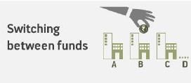
Different ways of investing money
In this you redeem your investment from one fund and invest to other.
Advantage of switching is you can exit from an underperforming fund and move to a better one.
Switching is also beneficial for planning your goals.

Slide 64
14. Redemption of Mutual fund

Slide 65

Redemption of Mutual fund
Redemption is the process where investor sells his mutual fund.
It means investor withdraw units to get back his money from the scheme.
Redemption can happen due to
Unexpected financial crisis.
Scheme underperforming since long.
Investor once reach their financial goal.
Types of redemption
Partial withdrawal – where some part of money can withdraw.
Full withdrawal – completely sell of mutual fund.

Slide 66
15. Growth or Dividend

Slide 67

Growth option scheme
Growth option is a cumulative option.
The profits made by the scheme are not paid in form of dividend. Instead, these get accumulated by reinvestment. Hence the NAV increases over time.
This is similar to the cumulative option in bank fixed deposit.

Slide 68
Why growth option?
Why one should go with Growth option scheme?
Can be suitable for investors having a long term investment horizon.
Growth plans are auto compounders.
Growth options helps to accumulate corpus by reinvesting the returns.
Dividends declared by companies are reinvested.

Slide 69

Pay out of Income distribution cum capital withdrawal option . (IDCW)
Dividends are the investor's portion in a company's profits.
In case of a dividend option scheme, fund manager declares dividend may be on monthly, quarterly, half-yearly or annual basis.
Dividend

Slide 70
Dividend option (IDCW)
Why one should go with dividend option scheme?
The value of NAV increases when the market is high resulting in more profit.
Scheme can be suitable for people expecting regular income.
Dividends may be paid annually,monthly,quarterly or half yearly.

Slide 71
Growth option or Dividend option (IDCW)
Want to Create Wealth?
Investors looking for wealth creation should go for growth option.
Need Regular Income?
Investors looking for regular income should go for dividend option for e.g. retired people.

Slide 72
16. Tax implication

Slide 73
Tax implications
Tax implication
Capital gain tax
STCG
A holding period of up to one year.
STCG is taxed at 15%.
LTCG
A holding period of more than one year.
There is no tax on LTCG of up to Rs. 1 lakh above that 10% tax
Direct distribution tax
(DDT) 10% to be deducted before paying dividend to unitholders

Slide 74


Slide 75


Thank You

